Slide 1


William Hunter Weekly Update: Week of 6/10
Oppoturtinity Hunter
June 14th, 2019

Slide 2



Weekly Objectives
What did I hope to achieve?
Store collected Data into SQL
Figure out ways to clean the data
Migrate operations to remote server
June 17, 2019

Slide 3

Storing in SQL
Weekly Progress
Learned SQL
Learned the basics of SQL, how the language works and other operations.
Created Tables
Created tables to store scraped data, ranging from more complex to very simple.
Created Queries
Created a query using pivot tables to successful manipulate the collected data.
Connected Python
Connected my python script with the server, and now data can be stored
June 17, 2019

Slide 4
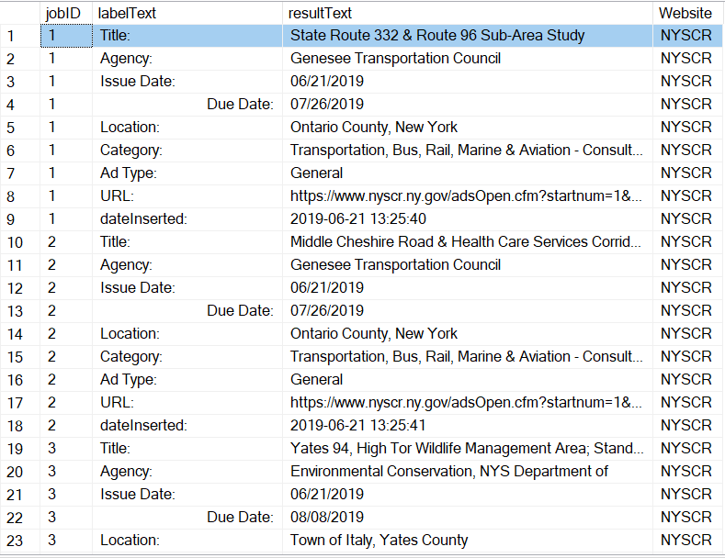
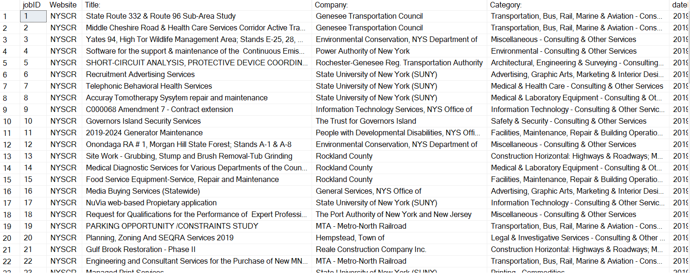
Data Cleaning
Weekly Progress
Took many different approaches
Python only cleaning
SQL only cleaning
Hybrid method
Python Method was too hard-coded
SQL method was very difficult
Hybrid method- search for tags in python, then store in SQL
Use pivot tables in SQL
Made code modular
June 17, 2019

Slide 5



Connecting to Remote Server
Weekly Progress
Finally got the Dallas VPN to work for me
Set up the database and necessary tables
Imported all of my code and scripts using GitHub
June 14, 2019

Slide 6



Challenges Encountered
Preliminary Difficulties with Opportunity Hunter
Scale
I tried to make the python scraping as module as possible to accommodate this, but the other sites’ HTML has to be explored as I may have to completely overhaul
the current too.
Automation
Having this process be fully automatic will be a challenge in the future. Louis has helped do some exploring, but we will need the python scripts to run in a IDE routinely.
Flexibility
When creating the scripts, I am constantly thinking back to how flexible I want to be, and to figure out when exactly to draw the line for where we have to take a
hard-code approach.
June 14, 2019

Slide 7




Expected Next Steps
Progressing Opportunity Hunter
Create Master Table
Create a single table for all of the websites information that will understand when data is old and new.
Another Website
Begin to reverse engineer another site and scrape it’s data, compare this with NYSCR.
Email Results
Figure out a way to automatically and easily email the results to the team automatically.
Scale
Continue to evolve the scripts and queries so that they can be applied to multiple sites.
June 14, 2019

